Slide 1
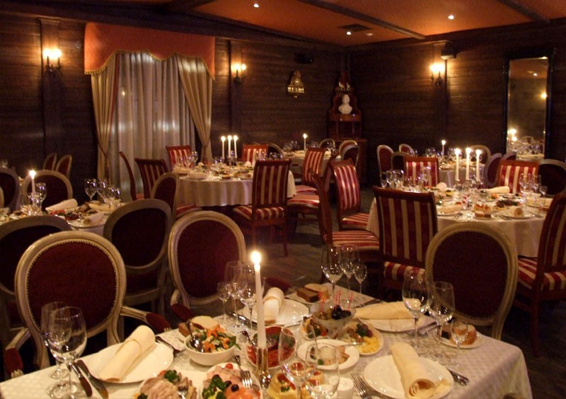
At the restaurant.

Slide 2
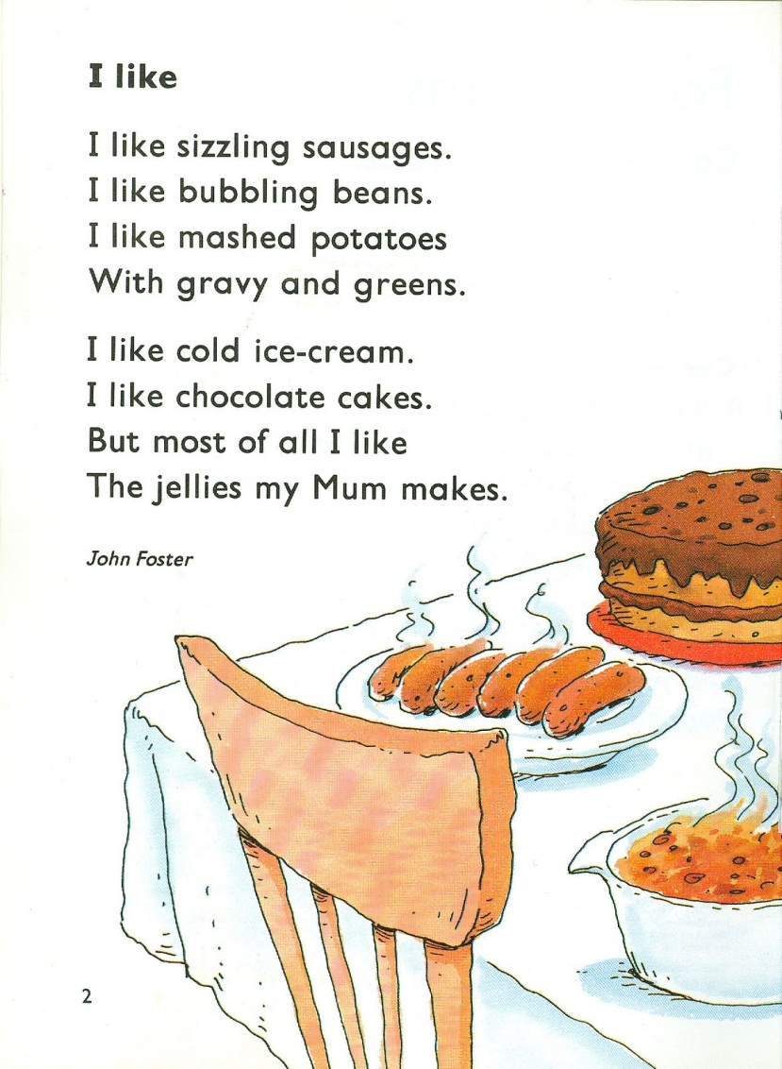

Slide 3
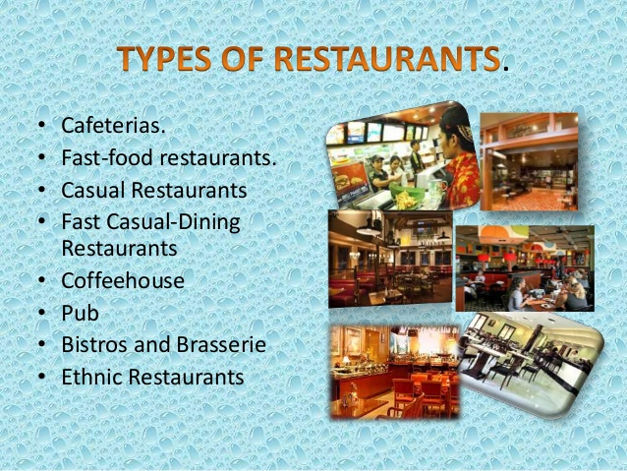

Slide 4
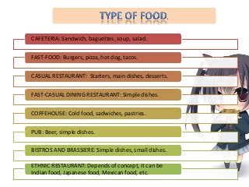

Slide 5
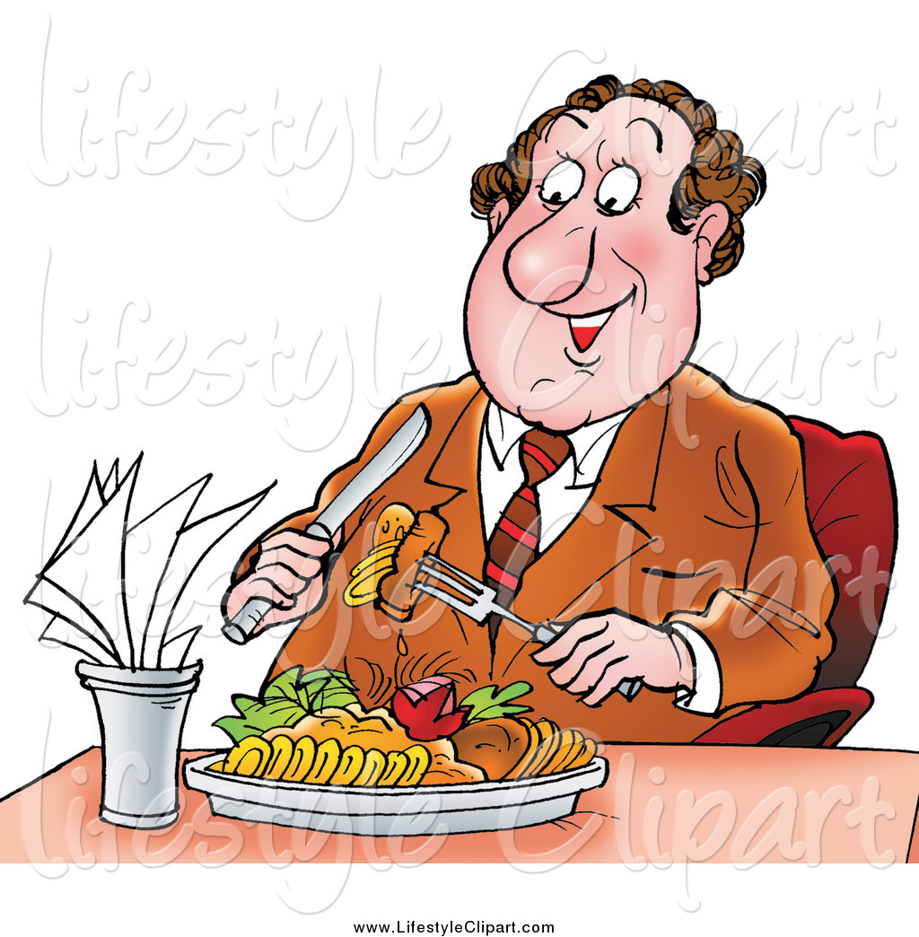
A food critic.
The terms food critic, food writer, and restaurant critic can all be used to describe a writer who analyzes food or restaurants and then publishes the results of their findings. While these terms are not strictly synonymous they are often used interchangeably, at least in some circumstances. Those who share their opinions via food columns in newspapers and magazines are known as food columnists. They are often experts in the field.

Slide 6
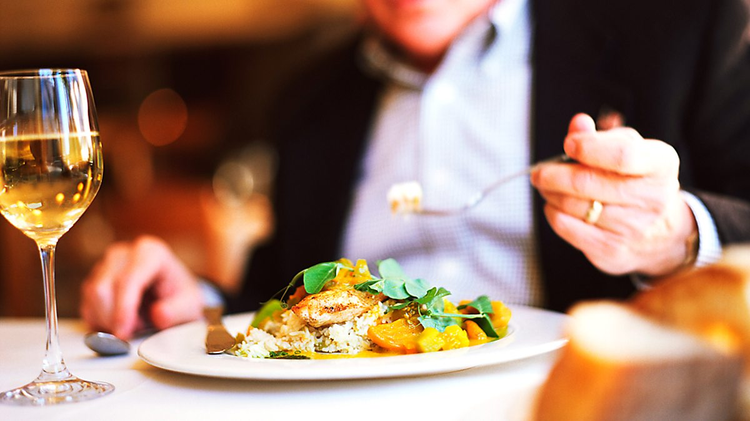
The Critic is Looking For…
Taste – this is what the critic values most.
Technique – the critic looks at how hard the food was to make.
Creativity – you’ll get bonus points here.
Presentation – you want your food to taste and look great.
Service – bad service is extremely off-putting. The critic looks at the attention of the service, how fast expectations are met, how friendly your staff is and how much they know about your menu.
Value – make sure your menu items are priced accurately.
The atmosphere – is it comfortable to dine in the restaurant?
Cleanliness – this is an absolute must. A dirty restaurant never makes a critic happy.

Slide 7
Positive | Negative
cosy atmosphere relaxed atmosphere tasty food, dishes helpful staff warm atmosphere varied menu informal atmosphere beautiful presentation popular dishes efficient service friendly staff, service international staff, food | high prices inexperienced staff slow service expensive prices, food tasteless food, dishes unusual presentation

Slide 8
